Slide 1
Microbiome workshop dada2 workflow (fastq to ASV)
Anujit Sarkar
Postdoctoral Scholar
COPH, CON
Genomics Program, USF
Apr 08, 2021

Slide 2
Analysis of 16S microbiome (fastq to ASV table or bacterial abundance table)
Fastq files are obtained immediately after 16S rRNA sequencing
We will analyze the fastq files using dada2 (https://github.com/benjjneb/dada2)

Slide 3
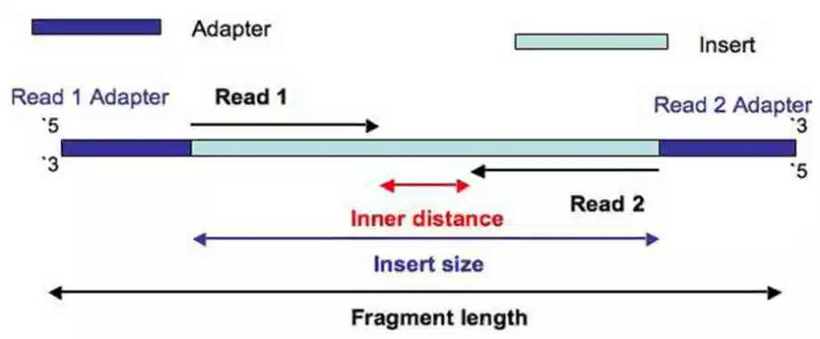
Paired-end sequencing of 16S amplicons
https://thesequencingcenter.com/knowledge-base/what-are-paired-end-reads/

Slide 4
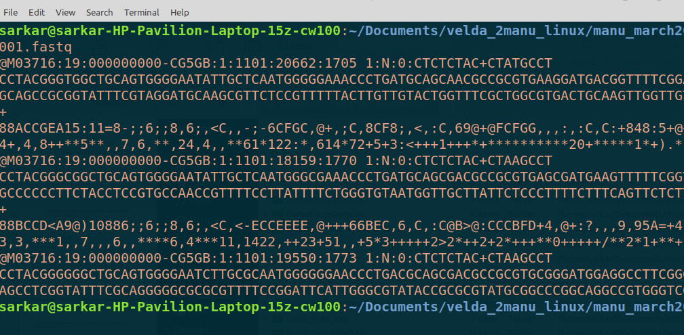
Purpose of this task
Sequence header
Sequence
+
Qscores (ASCII characters)
Start
Sample | Streptococcus | Veilonella | Prevotella
Sample1 | 25 | 4 | 45
Sample2 | 14 | 0 | 25
Sample3 | 42 | 32 | 0
End

Slide 5
What do you need before starting the analysis
R and Rstudio with dada2 installed
Demultiplexed paired-end fastq files (preferably from Illumina, for this workshop) stored in a folder/directory
An empty folder where all your results will be exported
A 16S rRNA database (Greengenes, Silva or 16S RDP) downloaded and stored in a folder
The path of all the files and folders mentioned above

Slide 6
Major steps for analysis (all in RStudio)
Setup your environment for the analysis
Apply quality filters to discard bad sequences
Learn error rates from your data
Infer Amplicon sequence variants from your forward and reverse sequences
Merge your paired-end filtered sequences
Make a table of the sequence variants (ASVs) in your data
Remove chimeric sequences
Track your workflow to monitor loss of sequences
Assign taxonomy to each ASV based on reference database
Save ASV taxonomy, ASV sequences and ASV distribution in your samples
Rarefy ASV table to equal depths (optional)
Remove ASVs whose total count is zero (optional)

Slide 7
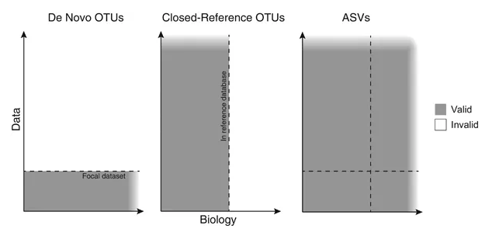
OTU vs ASV
ASVs are truly of biological origin
ASVs can identify up to single nucleotide differences
https://www.nature.com/articles/ismej2017119#Sec2

Slide 8
Get data from Illumina BaseSpace
https://login.illumina.com/platform-services-manager/?rURL=https://basespace.illumina.com&clientId=basespace&clientVars=aHR0cHM6Ly9iYXNlc3BhY2UuaWxsdW1pbmEuY29tL2Rhc2hib2FyZA&redirectMethod=GET#/

Slide 9
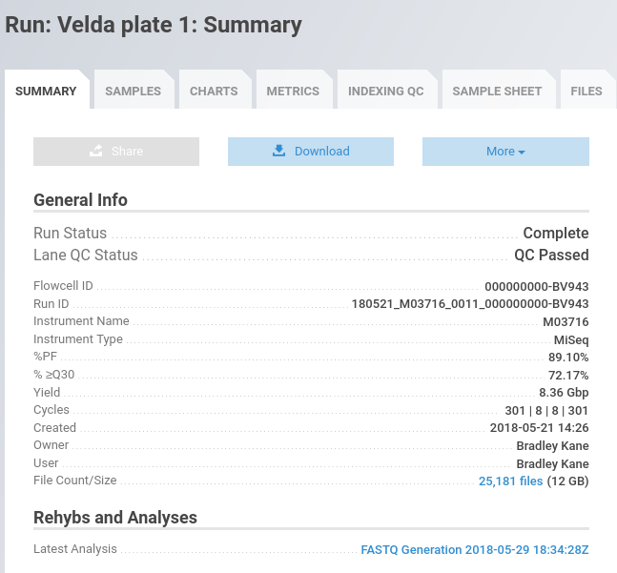
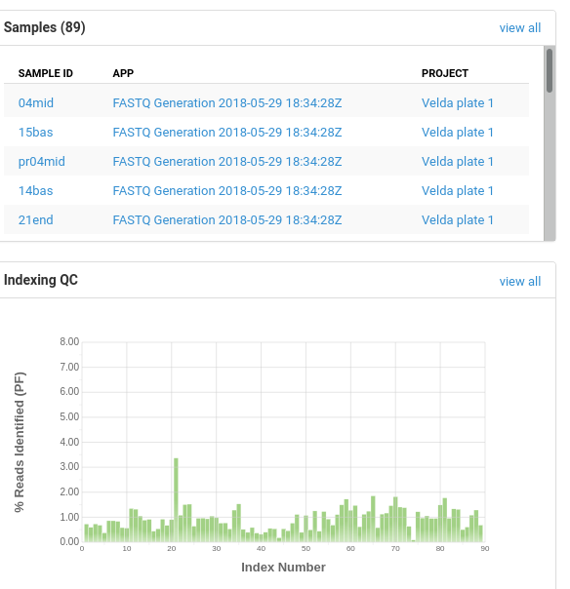
Summary of sequencing run in BaseSpace

Slide 10
Download Fastq files

Slide 11
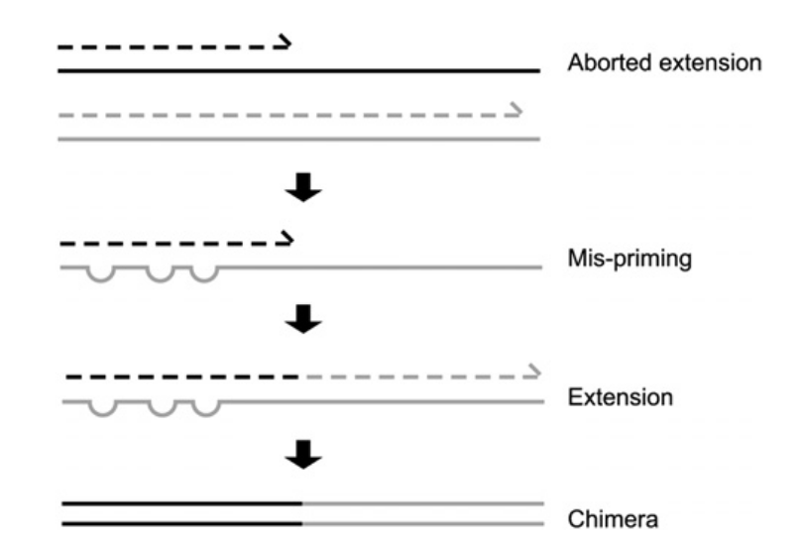
Chimera formation during 16S PCR
https://www.ncbi.nlm.nih.gov/pmc/articles/PMC3044863/

Slide 12


